Slide 1
Acoustic levitation using a TinyLev acoustic levitator
Progress Report One
Dalton Ludington
Daniel Opdahl

Slide 2
Goal
To determine what is the largest specific weight of an object of set volume that can be levitated?
Notes:
The definition of specific weight is an object’s weight on Earth per unit volume of material
Our Testable research question™ is “What is the largest specific weight of an object of set volume that can be levitated?”

Slide 3
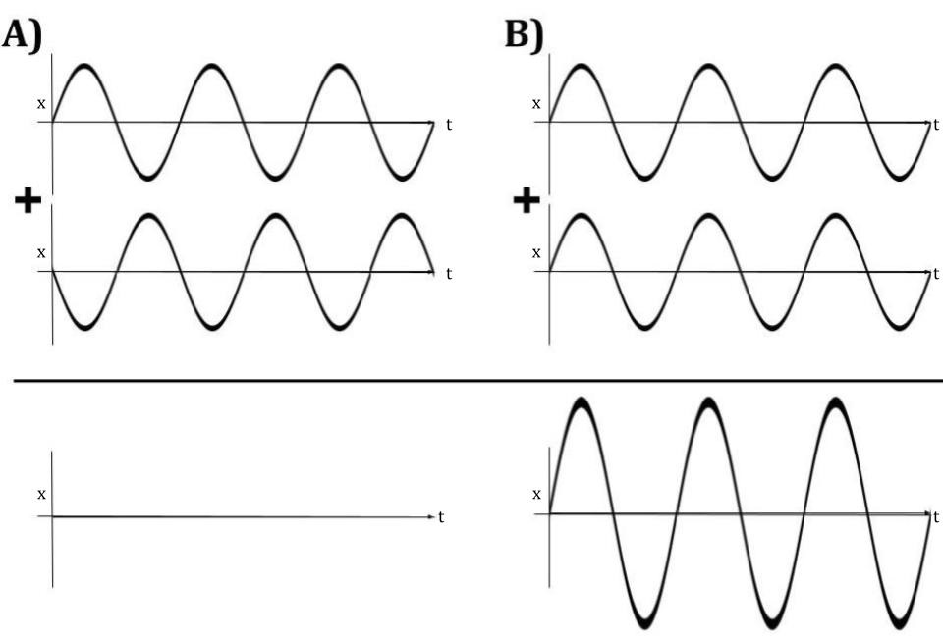
Standing waves
Notes:
Wave is made of high and low pressure that travels through air.
Areas of pressure correspond to displacement of air molecules from original position
2 waves can combine to constructively or destructively interfere

Slide 4
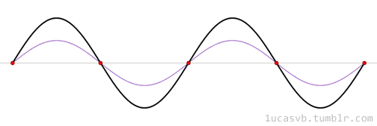
Standing waves
1ucasvb’s lab. “Standing waves (aka stationary waves)” 19 Mar 2013, 20:40, https://1ucasvb.tumblr.com/post/45792819532/standing-waves-aka-stationary-waves-standing#notes
Notes:
Standing waves are the real kicker for our theory
2 waves, red and blue, combine to the solid black wave
Note how in a standing wave the location of peak displacements don’t move through space
Red dots are nodes, and in between the red dots are antinodes
Nodes = low displacement, high pressure
Antinodes =oscillate between high and low pressure

Slide 5
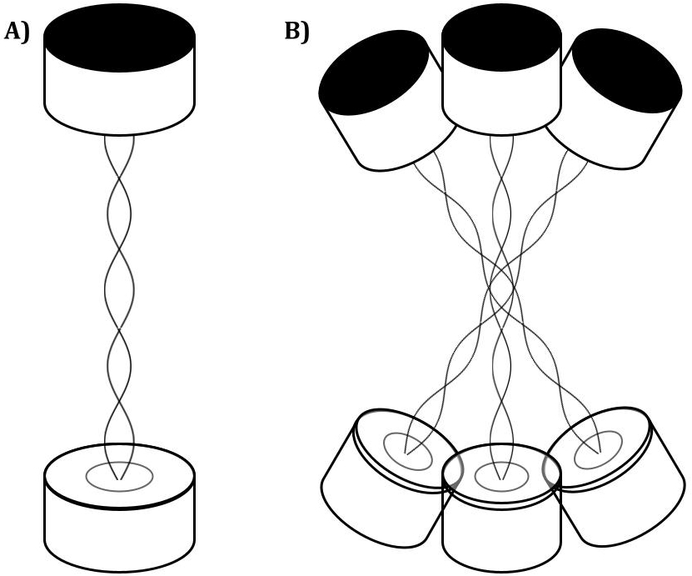
Acoustic levitation
Notes:
We place transducers in opposing pairs that create standing waves, as in A
If many pairs of opposing transistors are arranged in a crescent or bowl shape, the center nodes created by each standing wave are all superimposed on one another.
This creates a focused central node, formed by the combination of all of the standing waves, as well as several nodes above and below the central node.

Slide 6
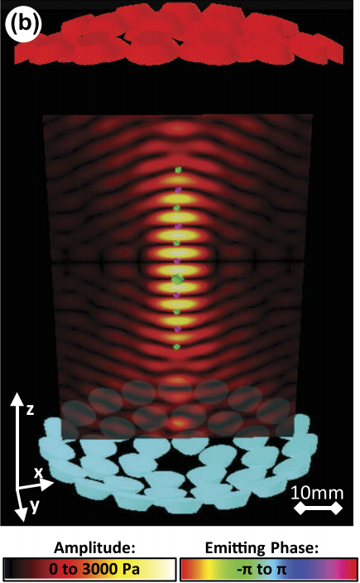
Acoustic levitation
Levitating objects are held in low pressure pocket surrounded by high pressure
TinyLev: A multi-emitter single-axis acoustic levitator. Asier Marzo, August 10, 2017. https://aip.scitation.org/doi/pdf/10.1063/1.4989995
Notes:
This is a more realistic model of the diagram before
Opposing transistors arranged in bowl shapes create many standing waves that combine to create several nodes (dark bands corresponding to small amplitudes) and antinodes (bright bands corresponding to large amplitudes). Objects (green and purple spheres) can be levitated in the nodes of the standing waves.

Slide 7
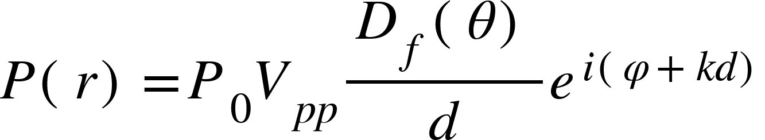
Determining the pressure
Far-field directivity function
Locating vector
Amplitude constant
Propagation distance
Wavenumber
Peak-to-peak amplitude
Emitting phase of source
TinyLev: A multi-emitter single-axis acoustic levitator (Additional Resources). Asier Marzo, August 10, 2017. https://aip.scitation.org/doi/pdf/10.1063/1.4989995
Notes:
In order to determine the largest specific weight of leviated object, we will be working with a model that relates the pressure to the force
For our purposes, at least initially, we want to focus on the central node for simplicity.
The equation above gives the pressure as a function of a locating vector r for a single transducer
This equation incorporates the voltage applied to the transducers, etc.
D(0) can be modeled as sinc = sinx/x
We will get the total acoustic field generated by all the transducers by simply summing the individual fields

Slide 8
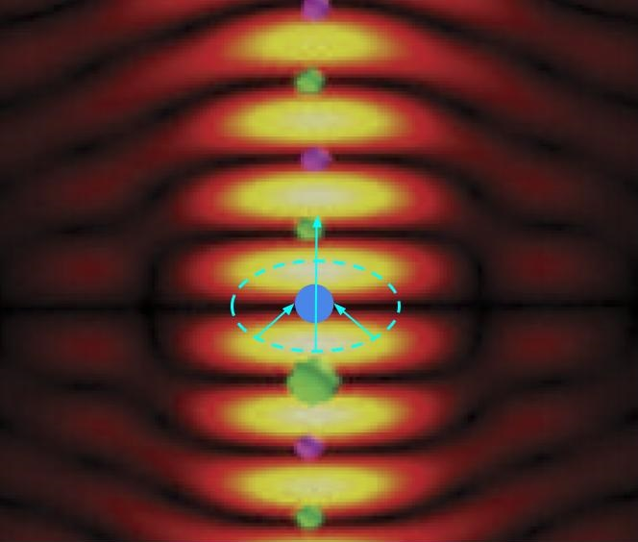

Determining the force
Force
Gork’ov potential
TinyLev: A multi-emitter single-axis acoustic levitator. Asier Marzo, August 10, 2017. https://aip.scitation.org/doi/pdf/10.1063/1.4989995
Notes:
Gorkov potential
In 1961, L.P Gor’kov derived the lowest order force on a spherical particle in an acoustic field.

Slide 9
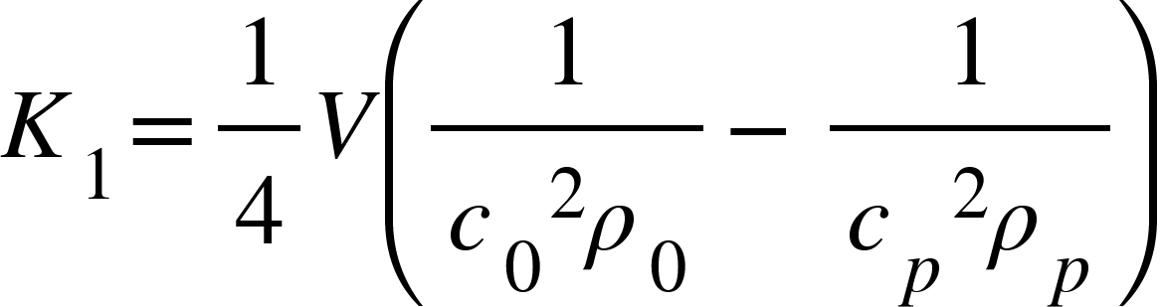
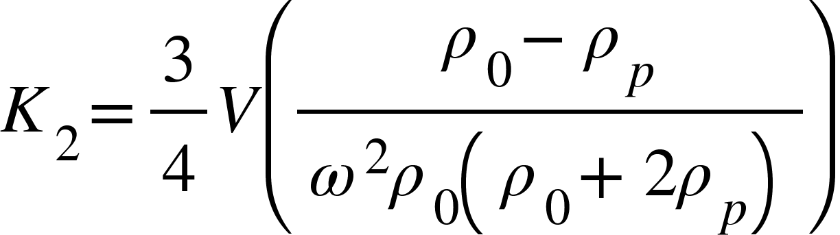
Gork’ov potential
TinyLev: A multi-emitter single-axis acoustic levitator (Additional Resources). Asier Marzo, August 10, 2017. https://aip.scitation.org/doi/pdf/10.1063/1.4989995
Complex pressure
Partial derivatives of complex pressure
Volume of levitated particle
Speed of sound through levitated particle
Speed of sound in air
Density of air
Density of particle
Notes:
We are writing matlab code to calculate these
We think that this is appropriate to answer our question because it allows us to calculate and model a complex pressure field from just the voltage applied, and a few constants that depend on our particular set up (transducers, air, etc.) and from that pressure field, we can get our force, which will allow us to say what the largest specific weight of a set volume we can levitate.

Slide 10
MATLAB code
Used to calculate pressure, Gork’ov potential, and force
Currently in the process of writing it
Notes:
We just took those equations from the previous slides and are working on putting them into code

Slide 11
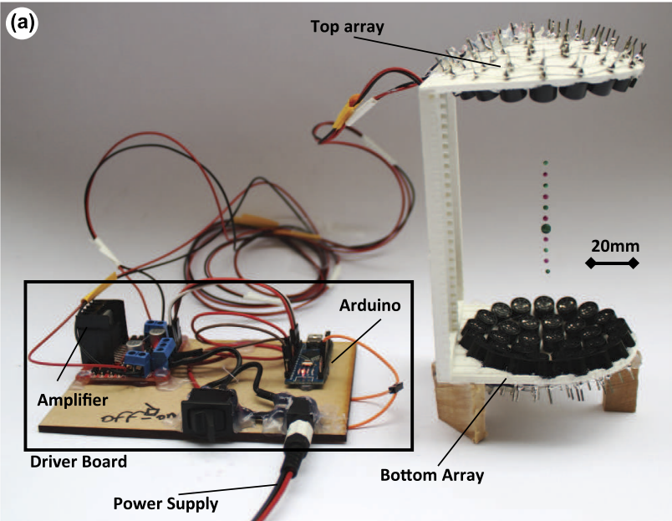
About the acoustic levitator
TinyLev: A multi-emitter single-axis acoustic levitator. Asier Marzo, August 10, 2017. https://aip.scitation.org/doi/pdf/10.1063/1.4989995
Notes:
We will use this to conduct our experiment by seeing if theory matched experiment. We will try levitating something around the specific weight that we found to be our maximum theoretically.

Slide 12
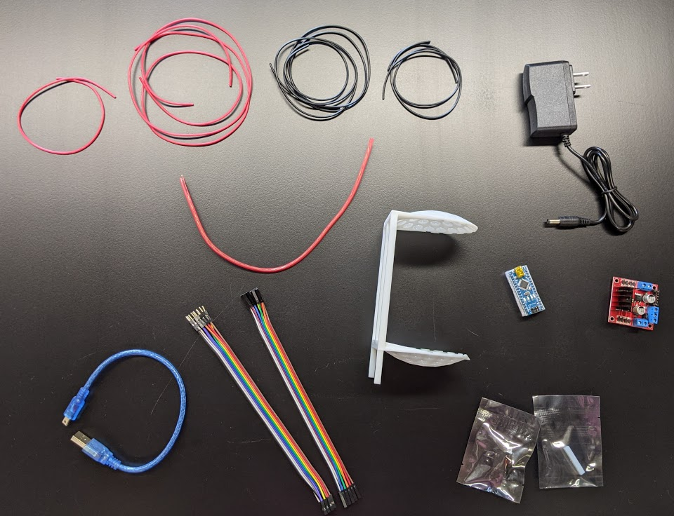
Construction of the levitator

Slide 13
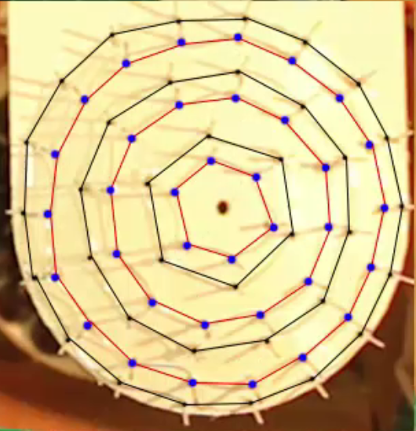
Construction of the levitator
TinyLev: A multi-emitter single-axis acoustic levitator. Asier Marzo, August 10, 2017. https://aip.scitation.org/doi/pdf/10.1063/1.4989995

Slide 14
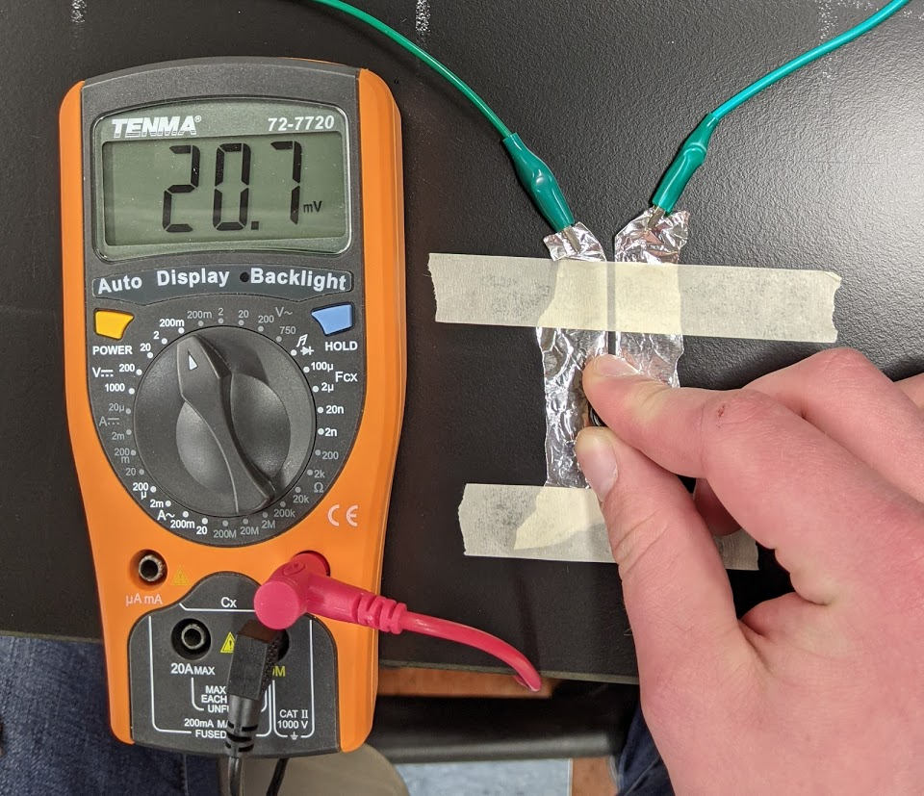
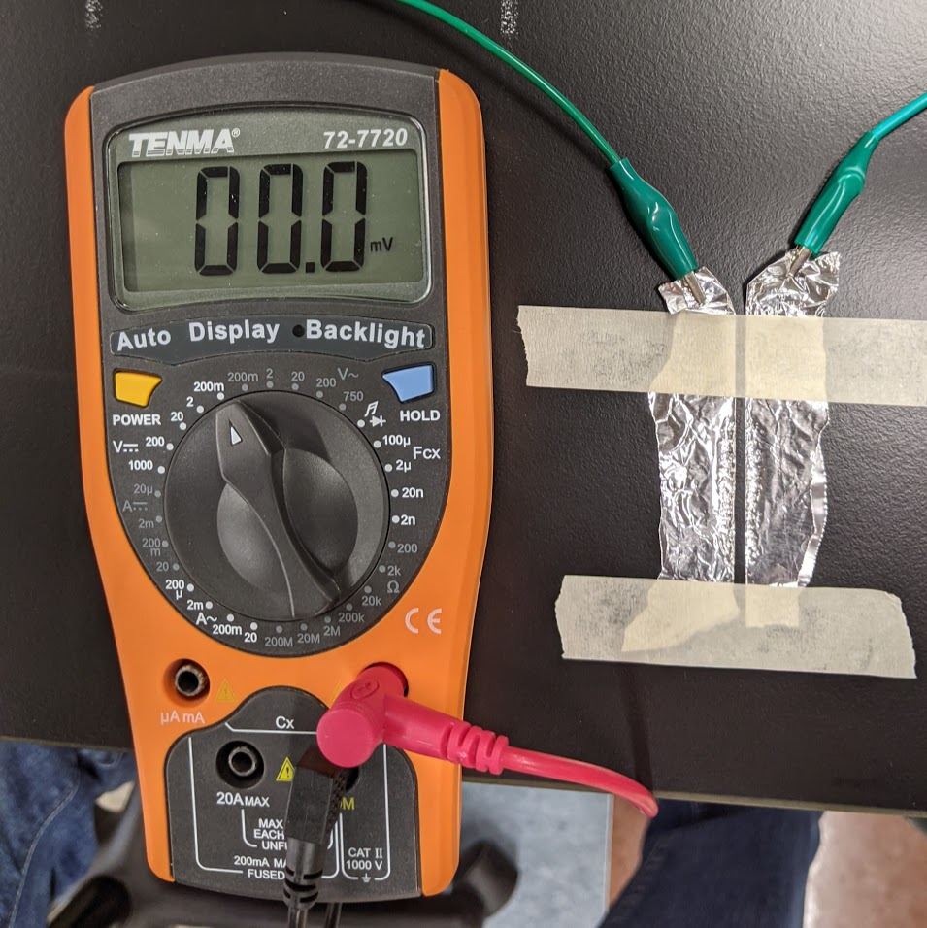
Testing transducers

Slide 15
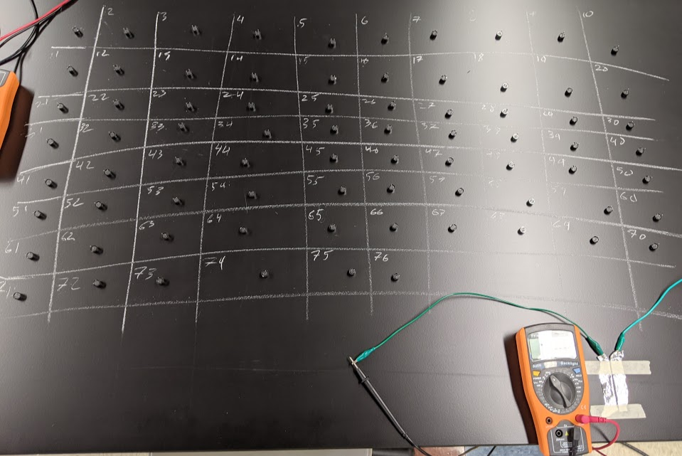
Testing transducers

Slide 16
Challenges
Determining the pressure output of the transducers
Balancing work between theory and device construction
Learning how to solder well
Writing the MATLAB script
Measuring constants to use in calculations
Notes:
Remember to talk about how we are working on solving each of these problems

Slide 17
Summary
Goal: To determine what is the largest specific weight of an object of set volume that can be levitated?
Standing waves
About acoustic levitation
Determining the force using the pressure and Gork’ov potential
About our levitator
Levitator construction and testing
Challenges

Slide 18
Questions?

